Slide 1
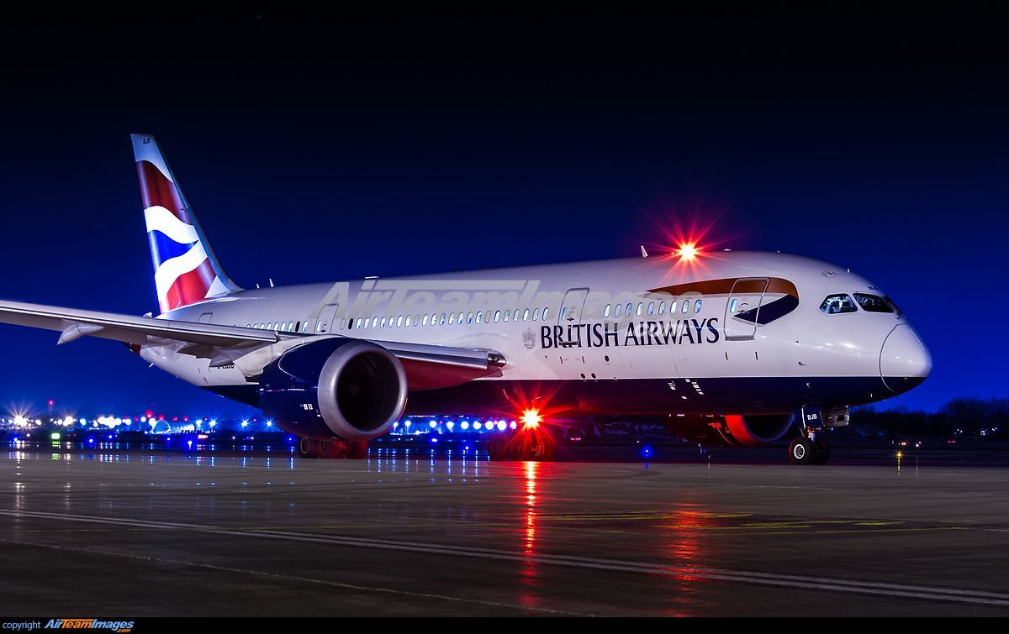
British Airways Review Categorisation Analysis
A Deep Dive into Process, Results, Insights & Strategic Recommendations

Slide 2
Why This Analysis Matters
Airlines operate in a reputation-sensitive industry where customer experience directly influences pricing power and brand equity.
British Airways receives thousands of online reviews that contain unstructured but valuable operational feedback.
This project converts raw text reviews into structured insight that management can act on.

Slide 3
Project Objective
The core objective was to categorise customer reviews into meaningful service themes and extract sentiment-driven insights.
Instead of reading reviews individually, we built a scalable NLP pipeline to detect recurring pain points and strengths.
The goal was not just classification, but actionable intelligence.

Slide 4
Data Collection & Preparation
The dataset consisted of customer reviews scraped from public platforms.
We cleaned the data by removing null entries, duplicates, punctuation noise, and non-informative symbols.
Text was normalised using lowercasing, stopword removal, and tokenisation to prepare for modelling.

Slide 5
Methodology: How Reviews Were Categorised
We transformed textual data into numerical form using TF-IDF vectorisation, capturing the importance of words relative to the dataset.
Reviews were then grouped into service-related themes such as delays, customer service, pricing, baggage, and inflight experience.
Classification techniques allowed us to systematically assign reviews to dominant complaint or praise categories.

Slide 6
Dominant Review Categories
Delays & Cancellations emerged as the most frequent complaint cluster.
Customer Service issues followed closely, particularly around communication during disruptions.
Inflight Experience and Cabin Crew professionalism drove most positive reviews.
Pricing & Value perception was mixed, with premium cabins viewed more favourably than economy.

Slide 7
Sentiment Trends Observed
Negative sentiment dominated reviews linked to operational disruptions.
Positive sentiment strongly correlated with staff professionalism and smooth journeys.
There was a clear emotional amplification effect: when delays occurred, overall ratings dropped disproportionately.

Slide 8
Interpreting the Findings
Operational reliability is the single strongest driver of brand perception in this dataset.
Customer service is not just about friendliness—it is most critical during moments of disruption.
Premium segmentation shows brand resilience, but economy service inconsistencies create reputational drag.

Slide 9
Strategic Recommendations
1. Prioritise Operational Reliability: Invest in delay-reduction initiatives and contingency planning.
2. Improve Disruption Communication: Real-time updates and proactive compensation messaging can mitigate sentiment collapse.
3. Standardise Service Experience: Reduce variance between routes and cabin classes.
4. Implement Continuous NLP Monitoring: Track review sentiment monthly to detect early warning signals.

Slide 10
Expected Business Impact
Improved operational reliability should reduce negative review volume and increase customer retention.
Better communication during disruptions can soften reputational damage and preserve loyalty.
Data-driven monitoring creates a feedback loop for continuous service optimisation.

Slide 11
Conclusion
This analysis demonstrates how unstructured review data can be transformed into strategic insight.
The key takeaway: operational performance and communication discipline are decisive drivers of customer sentiment.
With systematic monitoring, British Airways can shift from reactive reputation management to proactive experience optimisation.

